Slide 1


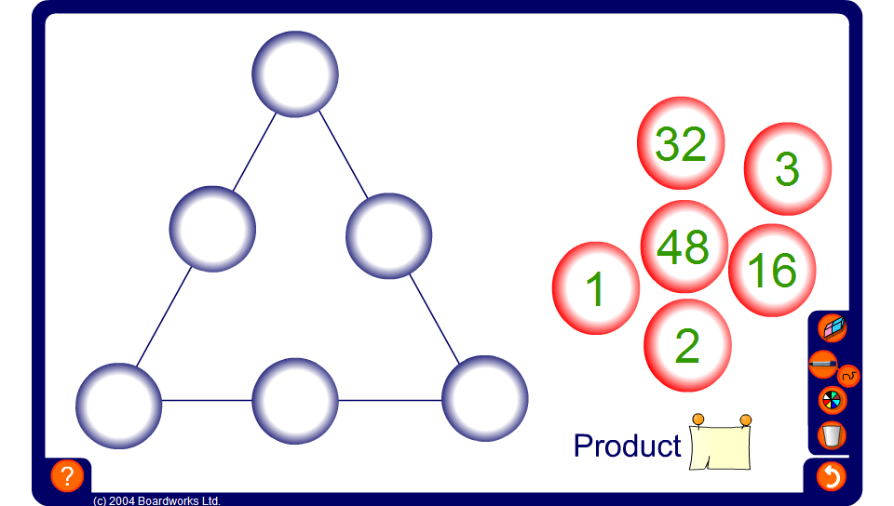
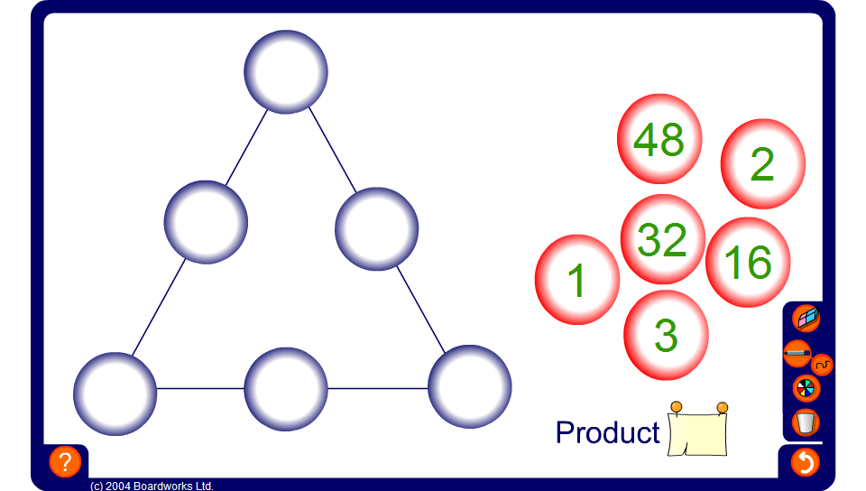

Product triangle
Notes:
Arrange the numbers on the right so that the product of the three numbers along each side of the triangle is the same. The product can be hidden or revealed to make the puzzle more or less difficult.

